Slide 1


Understanding Barriers to Hepatitis C Treatment:
Findings from Interviews with People Who Inject Drugs
Better Health & Education Outcomes. For All.

Slide 2


Thank you to:
Site staff
Viral Hepatitis Advisory Committee
DPH Working Group

Slide 3
Table of Contents
1
Background and Methods
5
HCV Treatment
2
Participant Characteristics
6
Themes - Stigma and Healthcare System Experiences
3
HCV Knowledge
7
Comparison of Findings to HCV Provider Assessment
4
HCV Testing
8
Summary of Key Themes

Slide 4
Background
& Methods
1
1

Slide 5
Research Questions
1
What beliefs do participants (people who inject drugs) in Massachusetts have about HCV infection, transmission, and treatment?
1
What barriers and facilitators do participants in Massachusetts experience related to HCV testing? What barriers and facilitators do they experience related to HCV treatment?
2
What strategies do participants in Massachusetts suggest to improve access to and utilization of HCV testing and treatment?
3

Slide 6
Data Collection & Analysis
1
Data Collection
Brief, semi-structured interviews at 3 syringe service programs (SSPs)
Inclusion criteria:
18 years or older
History of or current injection drug use (IDU)
English or Spanish-speaking
Data Analysis
Verbatim transcription and translation of interview recordings
Team-based codebook development and analysis approach
Thematic analysis of interviews

Slide 7




Interview Question Topics
1
Knowledge of HCV
HCV testing experiences
HCV treatment experiences
Optional demographic questions
Note: Participants were not directly asked to disclose their HCV status, but many participants chose to disclose past or present HCV infections.

Slide 8
Participant Characteristics
2

Slide 9
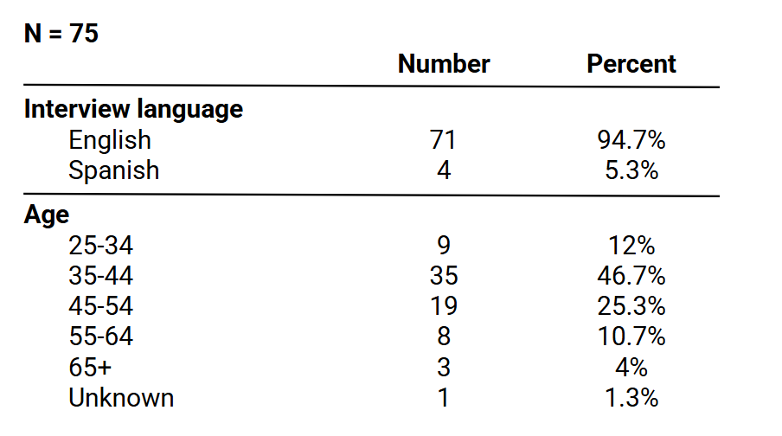
Participant Characteristics: Language & Age
2

Slide 10
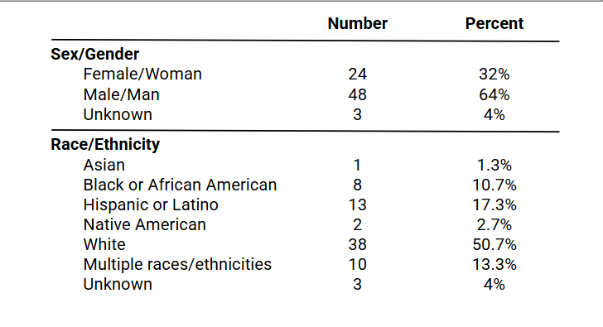
Participant Characteristics: Sex/Gender & Race/Ethnicity
2

Slide 11
Participant Characteristics: Testing & Treatment
2
Testing
74/75 (99%) of participants had ever been tested for HCV.
Testing locations:
Primary care provider (PCP)/doctor’s office
SSPs
Hospital
Jail/prison
Substance use disorder (SUD) treatment program
Treatment
21/75 (28%) of participants had ever received treatment for HCV.
Treatment locations:
PCP/doctor’s office
SSPs
Jail/prison
SUD treatment program

Slide 12
HCV Knowledge
3

Slide 13
HCV Infection Knowledge
3
HCV was most often described as an infection that affects the liver.
Many participants identified HCV as serious and potentially fatal if not treated.
Most participants did not describe symptoms of HCV or did not know about symptoms when asked.
Some participants had a limited or abstract understanding of HCV or confused HCV infections with other infectious diseases (HIV, HAV, HBV).
“It's a serious thing, because it's quite dangerous. I've seen many of my friends who have died from hepatitis C.”
SSP Participant
“...I don't know if I'm correct or not, but I know that, um, it can turn into HIV.”
SSP Participant

Slide 14
HCV Transmission Knowledge
3
Most participants identified IDU as a mode of HCV transmission.
Participants also identified that HCV is spread through blood and can be transmitted during sex.
Some participants had a limited or incomplete understanding of transmission or named inaccurate modes of transmission (saliva, proximity to someone with HCV).
“I...I know that it is, um, like a blood disease, um, usually caused by sharing needles or like blood-to-blood contact…”
SSP Participant

Slide 15
HCV Treatment Knowledge
3
Participants had differing knowledge about whether HCV could be cured with treatment.
Participants recognized that HCV treatment involved pills and that there were different treatment options.
A few participants mentioned interferon and/or recognized that treatment options have improved.
Few participants thought or had heard that abstinence from substance use is required for treatment.
“...It doesn’t go away. It’s just dormant.”
SSP Participant
“I know there's all kinds of treatment, like there's pills now that, uh, have really no side effects.”
SSP Participant

Slide 16
HCV Anecdotes
3
Some participants knew people who had or has HCV, had been treated for HCV, or died from HCV.
Participants had heard about interferon from friends and family. They discussed its negative side effects and even deaths from the treatment.
Some participants mentioned witnessing negative treatment experiences among friends and family, while others witnessed positive treatment experiences.
“I've seen so many people get turned away that want treatment, that can't get treatment … eventually [they] just say, "Oh, screw it," and they don't end up getting it done.”
SSP Participant
“I saw a couple of friends of mine who took the treatment and it worked for them.”
SSP Participant

Slide 17
HCV Testing
4

Slide 18
Hepatitis C (HCV) Testing
4
Nearly all participants have been tested for HCV at least once.
Participants discussed ease of testing at SSPs and also reported testing at jails, treatment providers, and primary care.
Reasons for getting tested include:
  Concerns about health
  Perceived risk for HCV
  Convenience of testing
  Testing recommendations or perceived requirements from providers/programs
“I think it would be helpful to get people tested, myself included, if, I think...if there's more pop-up things like that, because you could do it on a spur of the moment, you know, because most people don't really take the time to go out and, you know, make an appointment to do it.”
SSP Participant

Slide 19
HCV Testing Challenges and Barriers
4
Some participants spoke about reluctance to get tested because of fear or anxiety about finding out results.
A small number of participants mentioned fear of needles as a reason they avoided testing.
Some participants described difficulty returning to their testing location to receive results.
  People spoke about ease of getting tested at jails and hospitals because of getting results sooner.
“That makes me nervous. It's like HIV too, like, you know, it makes you nervous. That's...that's the big part of not wanting to get a test because you don't want to know the positive results.”
SSP Participant

Slide 20
HCV Treatment
5

Slide 21
HCV Infection Experiences
5
Most participants believed they contracted HCV from using and sharing needles. Other perceived sources included sex, a tattoo, and a blood transfusion.
Participants described HCV symptoms including effects on their liver, fatigue, weight loss, and pain.
Some participants described having no symptoms of their HCV infection.
Nine participants shared that they had ‘cleared’ or ‘gotten rid of’ HCV without treatment.
“I used a needle from someone that I was pretty sure had it.”
SSP Participant
“I mean, I feel it. It hurts. My kidneys, my liver, everything hurts, all day, every day.”
SSP Participant
“My body just fought it off on its own. I'm like one of those 10% people.”
SSP Participant
Notes:
.

Slide 22
HCV Treatment Motivation
5
Nearly all participants said that if they needed HCV treatment and/or re-treatment in the future, they would want to be treated.
Reasons for seeking treatment included:
Improving overall health and wanting to be cured of HCV
Wanting to live longer
Concern about spreading HCV to others
Ease/availability of treatment
Wanting a “fresh start”
“To get to like brand new again.”
SSP Participant
“It's gonna help me feel better.”
SSP Participant
“...if I was gonna die from something, I didn't want [it] to be something that I could easily cure and treat…”
SSP Participant

Slide 23
HCV Treatment Experiences
5
Participants received treatment while navigating different circumstances and challenges, including active substance use, substance use disorder recovery, prison or jail, and unstable housing.
Direct Acting Antivirals
Many participants treated with direct acting antivirals (DAAs) described treatment as straightforward, simple, easy, and effective.
Most participants experienced mild or no side effects.
Interferon
People treated with interferon described numerous and significant challenges and side effects.
Several participants treated with interferon later received treatment with DAAs.

Slide 24
HCV Treatment Barriers
5
Treatment gatekeeping by healthcare providers (sobriety requirements, disease progression requirements)
Challenges with healthcare system navigation (appointments, prescriptions, health insurance)
Challenges compounded by unstable housing or managing other health problems
Medication difficulties (taking large pills, storing/transporting pill boxes)
“...when I went to the stomach doctor,..., I asked him for the treatment and he said, ‘You gotta be sober for six months and prove it.’ So I never went back again...”
SSP Participant
“Because I'm homeless, so it's hard for me to keep up with pills.”
SSP Participant

Slide 25
Suggestions for Peers
5
Participants were asked “What would you like people who use drugs to know about getting tested or treated for hep C?”
Participants shared that:
Getting regularly tested and treated is important for health and to prevent HCV transmission
Testing and treatment is easy and readily available
Treatment is effective and has improved
“It's worth getting tested and...and getting treated, I mean, you know, you don't wanna give it to somebody else if you share needles, or if somebody picks your needle up off the ground because they're really sick and they need a needle or whatever, you know?”
- SSP Participant

Slide 26
Suggestions for Peers (continued)
5
“Because from my brother and from people in my family that have done the treatment, they actually recovered 100% and healthy. … So I've been there to see that happen. So all I can tell people is that, listen, it works, because I've literally seen it happen.”
SSP Participant
“I'd like them to know that it's not, uh, not like painful or discomforting because I know a lot of older people that, you know, didn't even wanna do the Epclusa because they remember the nightmare stories of interferon.”
SSP Participant
“Just maybe not be so scared about it. Just know that there's a cure and you can get treated”
SSP Participant

Slide 27
Stigma and Healthcare Experiences
6

Slide 28
Healthcare System Experiences
6
Many participants referenced a perception of stigma related to drug use and HCV among healthcare providers. Participants referenced feeling judged, disrespected, and dismissed by healthcare providers
“Some people look at you like you have 10 heads when you say you do have it...”
SSP Participant
“...depending on where you go, a lot of them are very judgmental and, uh, it kind of changes the whole level of treatment they give you as soon as they hear why you're there, or what reasons you think you might have hep C or something like that.”
SSP Participant

Slide 29
Healthcare System Experiences (continued)
6
“They won't see me, they blame everything on drugs, and I'm, like, tired of it. It's like, I mean, I suffer and I go through all this pain and I end up in the ER a lot, but I can't even get the help I want because they want a freaking clean drug screen. And you know, what about everything else? You're worrying about drugs killing me, but everything else is killing me.”
SSP Participant

Slide 30
Suggestions for Providers
6
Participants were asked “What would you like providers to know about how people who use drugs access hep C testing and treatment?”
Responses discussed:
Stigma and judgement related to substance use
Wanting to be provided with clear knowledge and information about HCV
Easier and more immediate connection to needed care
“I think just treat us like humans, um, compassion, and not everybody's in the same place at the same time, uh, but everyone deserves help.”
SSP Participant

Slide 31
Comparison of Findings to HCV Provider Assessment
7

Slide 32
Hospital Assessment Background
7
In 2024, JSI assessed HCV testing and treatment protocols and workflows within several large MA hospital systems.
29 key informants across 6 high-volume hospital systems were interviewed (included providers and other hospital staff)
All key informants were involved in the HCV continuum of care
Determining testing eligibility
Ordering tests
Treating patients with HCV and/or liver complications)

Slide 33
Key Finding: Challenges and Facilitators of HCV Care Continuum
7
Provider-Reported Challenges
Patient related challenges: Housing, communication, transportation, financial concerns, substance use disorder, HCV not a priority
Hospital level challenges: Heavy work loads, long wait times for care, inconsistency in the referral process
“It’s hard to care about an invisible virus when you’re going hungry, right?”
Provider

Slide 34
Key Finding: Challenges and Facilitators of HCV Care Continuum (continued)
7
Provider-Reported Facilitators
Contributions of navigators, community health workers, medical assistants, mid-level providers, and pharmacists
Bridging social determinant gaps through connection with community-based organizations and prison systems
Support for uninsured patients
Treating patients like VIPs: services in non-traditional settings, mobile/home visits, interpretation services
“ I think it's really important, ultimately, for us to apply test and treat approaches in one sitting wherever possible, particularly among the high-risk populations who are at highest risk, not only of having it, but of course of transmitting it”
Provider

Slide 35
Summary of Key Themes
8

Slide 36
Key Findings for Service Development & Capacity Building
8
HCV Knowledge
Most participants had basic knowledge of HCV infection, particularly how HCV is spread.
Participants perceive HCV as serious and potentially fatal.
However, participants knew less information about HCV treatment, particularly that HCV is curable with treatment.
HCV Testing
Participants understand the importance of getting tested for HCV and received testing from a wide variety of testing providers.
Convenience and ease of accessing testing are important factors for uptake.

Slide 37
Key Findings for Service Development & Capacity Building (continued)
8
HCV Treatment
Although providers thought that HCV was not a priority for patients, nearly all SSP participants said they would want to be treated for HCV.
Participants are motivated to seek treatment for a variety of reasons, but face challenges interacting with and navigating the healthcare system.
Healthcare Experiences
Participants perceive drug use- and HCV-related stigma among healthcare providers and have had negative experiences interacting with the healthcare system.
HCV care facilitators identified by providers are in alignment with the needs of SSP participants

Slide 38
Questions & Discussion

Slide 39
Resources
Massachusetts HCV Elimination Plan
Toolkit: Testing and Treatment of Hepatitis C in People Who Use Drugs (PWUD)
Resource: Strengthening Syringe Service Programs: Employment and Volunteer Pathways for People with Lived Experience

Slide 40

Thank you!
Please complete your evaluation!

